Slide 1
Field Training Officer
Functions and Qualities of Field Training Officer

Slide 2
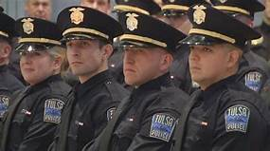
Introduction
A FTO is an experienced member of the organization (Idris, 2018).
They are expected to train juniors.
Their roles are used in fire and law enforcement departments.
They receive specialized training.
Notes:
Field training officer is a role that requires the individual to have experience in order to train juniors (Idris, 2018). In addition, field training organizations are mainly in medical services, fire and law enforcement departments since they require specialized skills which are mostly practical.

Slide 3
Importance of the Field Training Officer
Young officers are taught are instilled with knowledge (Edwards & Meade, 2015).
They learn different skills as they understand their roles.
Young officers understand the needs of the profession.
They also get multiple approaches to solve situations.
Notes:
One of the main functions of FTO is to teach young officers the right way to do the job (Edwards & Meade, 2015). This is fundamental since it enables the young officers to embrace the profession and avoids committing mistakes when they are delivering services. As a result, human safety is promoted.

Slide 4
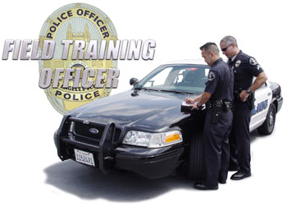
Importance of the Field Training Officer (Cont.)
It is one of the best paying careers in law.
Officers understand the law in a better way (Idris, 2018).
It acts as a platform for other careers in law.
It embraces flexibility and freedom.
Notes:
FTO is one of the best careers in terms of payments. According to Idris (2018), officers tend to understand the law well hence being able to act according to the expectations of their customers. Hence, it enjoys freedom and flexibility since it is not demanding.

Slide 5
Major Qualities of FTO
FTO is expected to translate experience and understanding into training.
Young officers gain detailed experiences and understanding (Cushion, 2018).
Training helps officers to be competent.
FTO’s are critical in specific departments.
Notes:
One major quality of the FTO is to translate experience and understanding into training (Cushion, 2018). This makes it easy for them to perform excellently in field operations since they have already become competent and experienced.

Slide 6
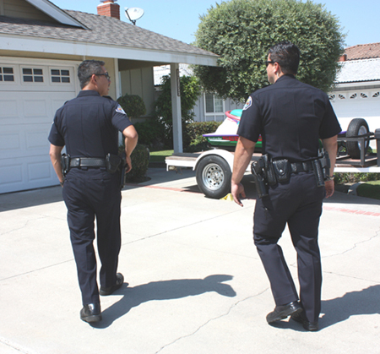
Major Qualities Of FTO (Cont.)
They also gain the attention, participation, and trust of the trainee.
Officers and trainees interact actively.
Trainees gain through the interaction (Cushion, 2018).
Competence is developed as a result.
Notes:
Officers are in a position to gain attention, participation as well as the trust of the trainee (Cushion, 2018). This is achieved through the training which involves interaction in the learning of new skills. High levels of competence are also developed.

Slide 7
Major Qualities Of FTO (Cont.)
Officers are able to develop awareness to trainees.
They are also responsible to instil decision making skills.
Trainees also gain confidence through training.
FTO’s promote people’s safety (Idris, 2018).
Notes:
FTO’s are usually tasked to develop awareness and responsibility to their trainees in order to increase competence (Idris, 2018). Through this, safety for the public is increased and also the improvement on the response towards emergency responses that may affect the public.

Slide 8

Conclusion
Field training officers promote the public’s safety.
Training should be thorough for the trainees.
Departments should add more FTO’s.
Conditions for learning should be improved.
Notes:
Field training officer career is one of the best careers since it has flexibility and freedom. Trainers should consider giving the trainees thorough training in order to ensure they are competenet and experienced in their work.

Slide 9
References
Cushion, C. J. (2018). Exploring the Delivery of Officer Safety Training: A Case Study. Policing: A Journal of Policy and Practice.
Edwards, S., & Meader, D. (2015). Officer Safety Initiatives.
Idris, M. (2018). The Impact of Education and Training, Work Discipline and Organizational Culture on Employee’s Performance: The Study of Disaster Management and Fire Department in Palembang City, Indonesia. International Journal of Human Resource Studies, 8(3), 1-18.

Slide 10
Presented by;

